Slide 1


Coffee Talk
A Coffee Brewing & Heart-to-heart Talking Simulator

Slide 2
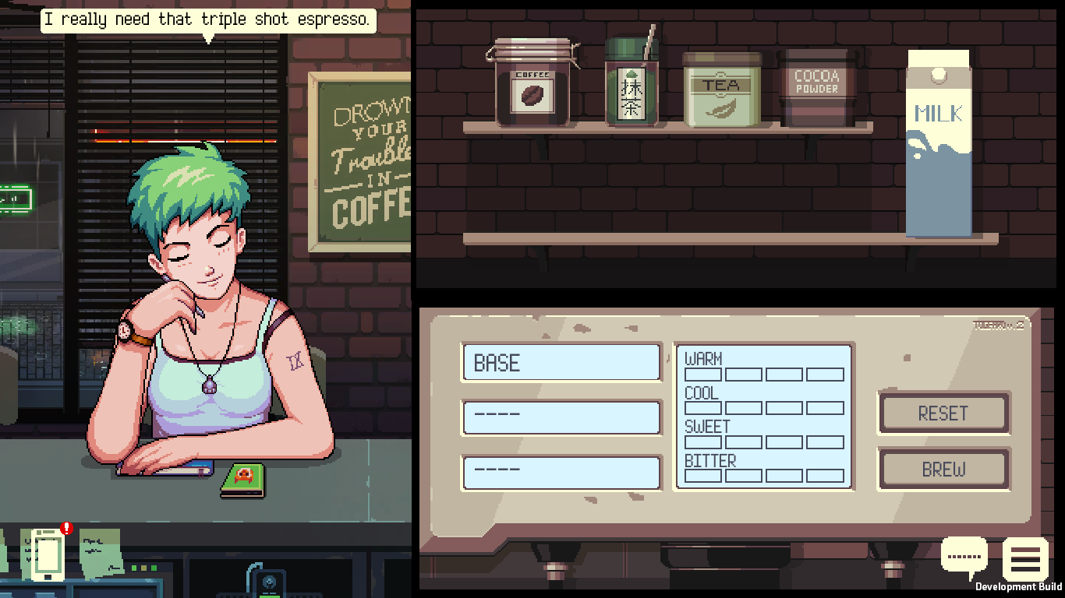
The Game
Coffee Talk is a game about listening to people’s stories and changing their lives, one warm cup at a time.
This is a game where you can wind down and relax. Experiment with different ingredients and brew warm drinks, meet interesting characters and listen to their stories over a cup of coffee, or two.

Slide 3

Game Overview
Release : Q2 2019
Platform : PC, Switch, PS4, Xbox One, iOS
Genre : Simulation/VN
Pricing :
PC and console: $12.99
iOS: $4.99 with only the first chapter. Use IAP to unlock the rest of the story.

Slide 4

“Imagine holding a warm cup, sitting next to a window,
while it’s raining outside, lo-fi music in the background,
and listening to your friends tell their stories.”
Fahmi Hasni
Core Experience

Slide 5
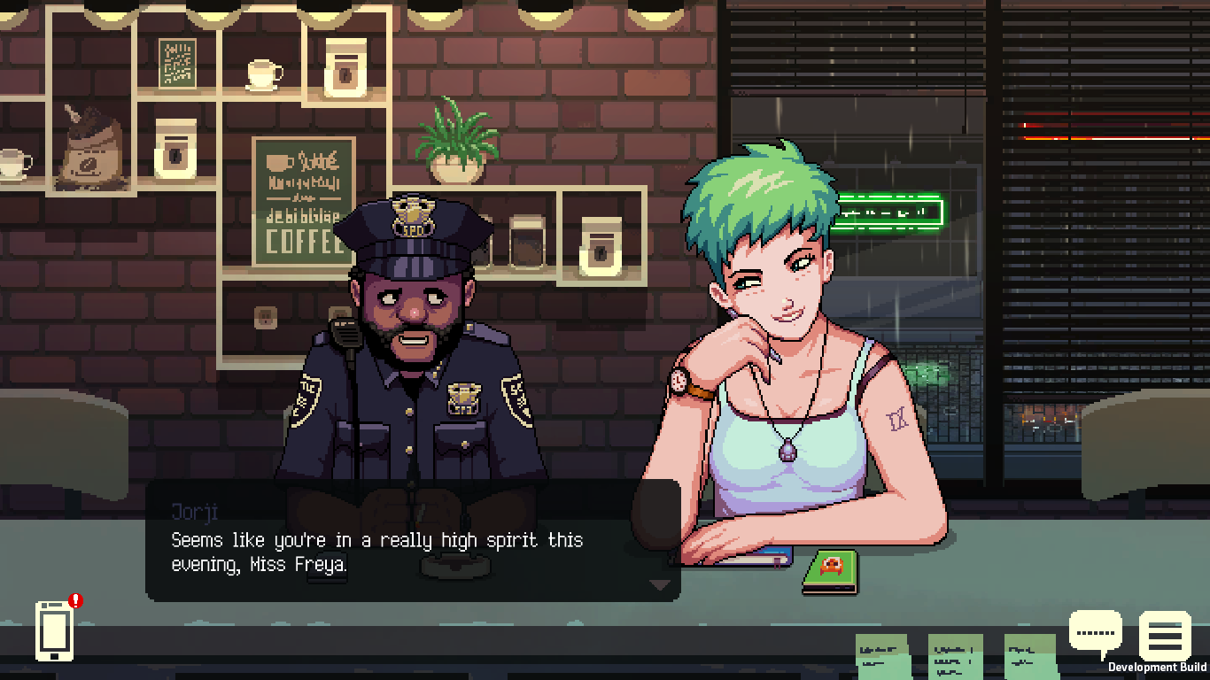
Core Experience
Unlike most games that emphasize on action, puzzle, or reward-punishment mechanics, Coffee Talk is built on three core values:
Tell stories that are interesting and relatable
Present the players with an audio visual experience that can help them feel relaxed, chill, and calm
Challenge, but don’t punish

Slide 6

Teaser Trailer

Slide 7
Features

Slide 8
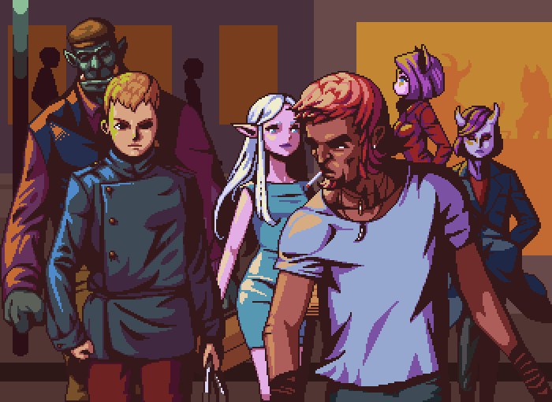
Narrative Experience Set in Urban Fantasy Setting
Tales of people from an alternate-Seattle, a city where elves, orcs, mermaids, and many other fantasy races live together with humans in a modern world we will all find familiar.
The game shows the diversity we have in real life, but presented in an unusual fantasy setting that will break player’s expectation of racial stereotypes and prejudices.

Slide 9
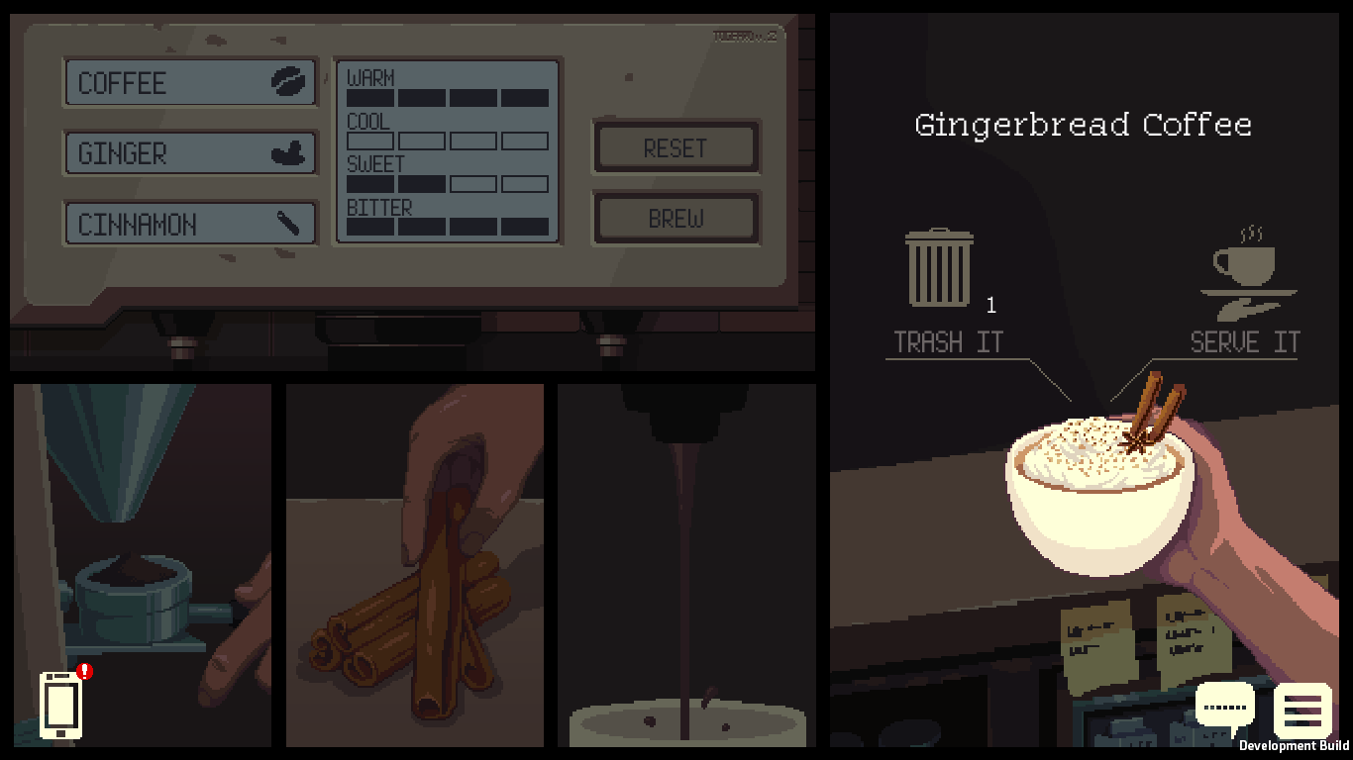
Branching Stories
Brew coffee, tea, and other warm drinks. Some drinks may influence people to open up better than others.
Find different conclusions of each character’s story by brewing different drinks according to or against their request.

Slide 10

Latte Art
Draw your own latte art on selected drinks, and share it online before serving it to your customers.

Slide 11
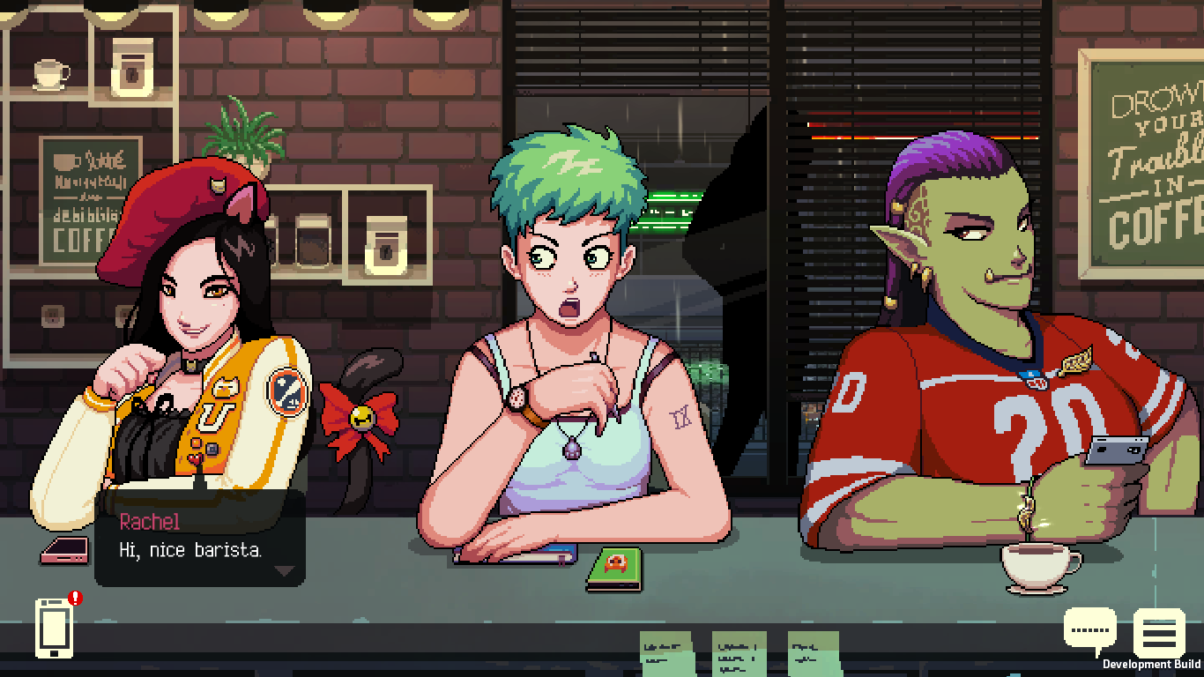
Fantastic Casts
A dozen of characters with their own unique personalities and stories. The designs of the characters were heavily inspired by 90s anime but presented in high definition graphics.
This is a game where you can find a freelance designer elf, biz dev executive succubus, a post-grad mermaid, programmer orc, and many others!

Slide 12

Relaxing Chill-Hop Music
Enjoy more than 20 relaxing jazzy chill-hop music tracks. Written and composed by Andrew Jeremy, one of Indonesia’s top game music composer.

Slide 13

Market Analysis

Slide 14
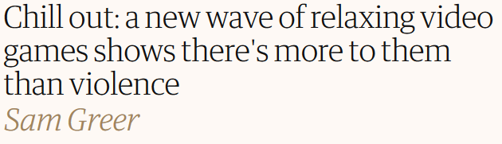
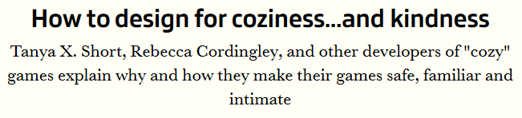
Target Market
Coffee Talk is targeted for players who just want to take a break from their hectic daily activities, tiring routinity, and are too overwhelmed with the challenges and adrenaline pumping action of most modern games.
This is the game for you who just want to rest, chill, and listen to good stories accompanied with relaxing environment, art, and music.
The Guardian https://www.theguardian.com/games/2018/jul/26/chill-out-relaxing-video-games
GameIndustry.biz
https://www.gamesindustry.biz/articles/2018-11-05-how-to-design-for-coziness-and-kindness

Slide 15
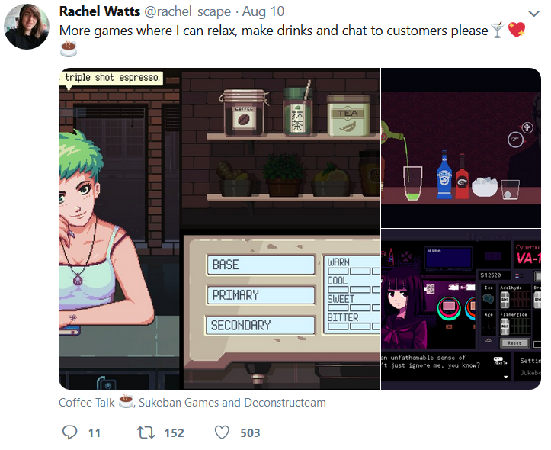

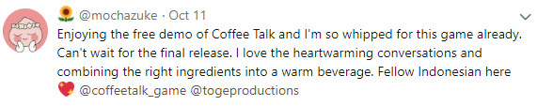

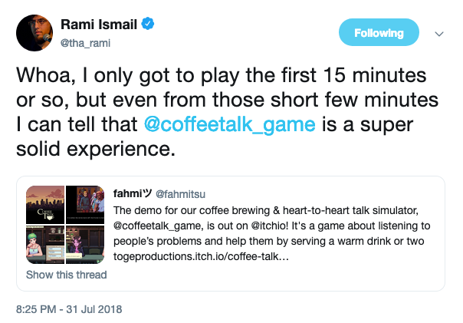
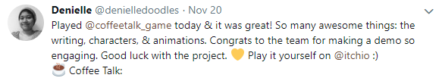
Market Potential
Coffee Talk is filling a niche market that’s craving for more content!

Slide 16
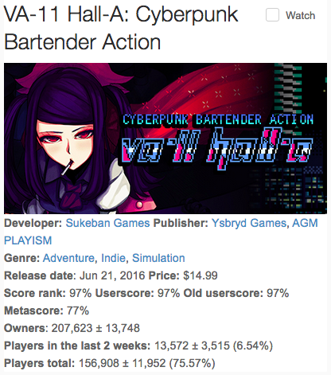
Comparison
The main comparison for Coffee Talk would be VA-11 HALL-A by Sukeban Games that was released in 2016 has been sold for over 290k copies (by mid 2018).
Fans have been asking for more games like VA-11 HALL-A, but there are just no one else. (maybe Red Strings Club) but that’s it!

Slide 17

Benchmark and Sales Projection

Slide 18
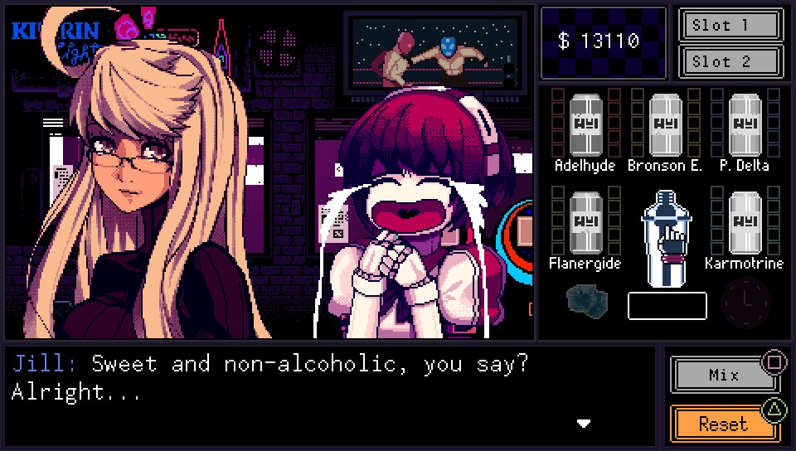

Benchmark
VA-11 HALL-A is an indie bartender simulation with visual novel elements as well as cyberpunk and anime-inspired visuals, developed by Venezuelan studio Sukeban Games and published by Ysbryd Games.
Approximately sold 290K copies in 2 years. Data from SteamSpy, SteamPrices, and ArsTechnica.
Estimated revenue:
290,000 * ($15*60% ) : $2,610,000
*60% were taken from the estimated cut after Steam cut and taxes

Slide 19
Sales Projection (First Two Years)
Low: 58,000 units sold
20% of VA-11 HALL-A sales estimation
Medium: 145,000 units sold
50% of VA-11 HALL-A sales estimation
High: 290,000 units sold
100% of VA-11 HALL-A sales estimation
Projection | Units sold | Price (mobile) | Price (console or mobile with IAP) | Revenue (mobile) | Revenue (full or with IAP)
Low | 58,000 | $5 | $15 | $290,000 | $522,000
Medium | 145,000 |  |  | $725,000 | $1,305,000
High | 290,000 |  |  | $1,450,000 | $2,610,000

Slide 20

Current State of the Game

Slide 21
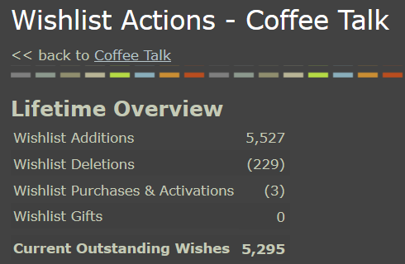
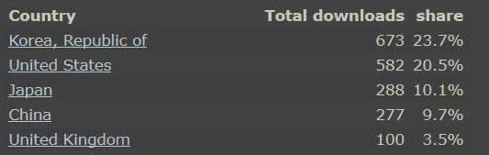
Statistics
With zero marketing budgets and a demo that is only available in three places (Steam, itch.io, and Gamejolt), Coffee Talk already garnered positive responses.
Steam wishlist: 5,295
Demo downloads across 3 platforms: 11,518
Donate-what-you-want demo earned $757
Data as of Mar 2019

Slide 22
What the internet said about Coffee Talk?
“Coffee Talk grounds you in a place and makes you feel comfortable. You’re just working a shift and shooting the shit. It’s not glamorous, but it feels right.” - Kotaku
“Coffee Talk feels like the kind of game that you could think of as your own refuge space, and that sort of experience is just as valuable as any big budget mega-game that sells itself on maximum interactivity or realistic graphical fidelity.” - Paste Magazine
“There’s a particular vibe to a good coffee shop; a chill atmosphere where people catch up with one another and enjoy a good hot drink. Coffee Talk captures that same vibe” - Rock Paper Shotgun
“Whoa, I only got to play the first 15 minutes or so, but even from those short few minutes I can tell that @coffeetalk_game is a super solid experience.” - Rami Ismail, Vlambeer
And many more!

Slide 23

Development

Slide 24
Development Timeline
2018
2019
Jan 2018 Game Jam Prototype
Mar 2018 Alpha 1
Jul 2018 Public Alpha Demo on itch.io
Aug 2018 Steam coming soon page live
Oct 2018 Localized demo to Korean and Chinese by fans
Nov 2018 Test demo built to console and mobile
Jan 2019 Taipei Game Show
Mar 2019 Latte Art mechanic
Apr 2019 Beta testing and polishing
June 2019 Gold build
Aug/Sep 2019 Launch target
Dec 2019 1st DLC
Dev Notes:
In reality Coffee Talk would be released on Jan 29, 2020
No DLC was released, instead we release Steam workshop modding support for localization and voice acting
CT2 was originally planned as the DLC became a full stand alone sequel and released on April 20, 2023

Slide 25
Demo Build
Test Flight available via invitation
Public link - Coming Soon
PC Demo Build
Steam
itch.io

Slide 26
Development Spent
Throughout the 14 months (Jan 2018 - Mar 2019) development, we have invested (in USD):
Team members cost (6 core team member) : $X/month x 14 months = $X
1 Director (Writer and designer)
1 Producer and Composer
2 Artists
2 Programmers
Proofreader (Retainer based $X/month) : $X
Tools and productions support cost : $X
Total : $X

Slide 27
Further Development Costs
Development Spent (Jan 2018 - Mar 2019) : $X
Team member cost until August 2019 ($X x 6 months) : $X
The time range includes testing, bug fixing, polish, maintenance
Localization (DE, FR, JP, Simplified CH, Traditional CH, KR) : $X
$X (cost per word) x 50.000 (number of words projected) x 6 (languages)
Post Launch Updates & DLC (Additional Story & Feature) : $X
1st DLC ($X x 3 months) + Localization ($X estimated)
2st DLC ($X x 3 months) + Localization ($X estimated)
3st DLC ($X x 3 months) + Localization ($X estimated)
Total : $X
Dev Notes:
The Post Launch Updates & DLC was canceled and would eventually changed into the development of Coffee Talk Episode 2, a stand alone sequel.

Slide 28
The Ask

Slide 29
What we are looking forx
Dev Funding
Console Porting & Physical Distribution
Marketing Support
etc.

Slide 30

Got any question?
Contact kris@togeproductions.com or publishing@togeproductions.com for more info

